Slide 1
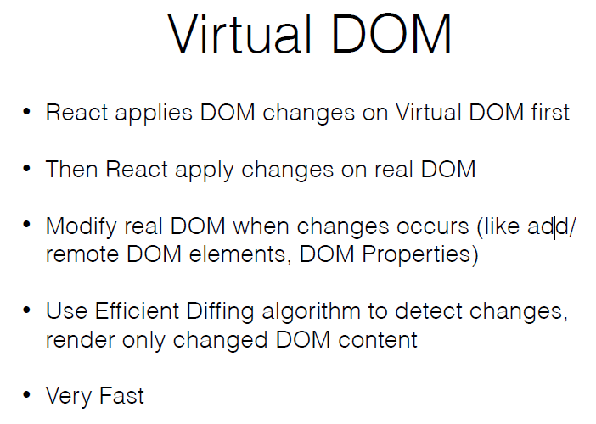

Slide 2
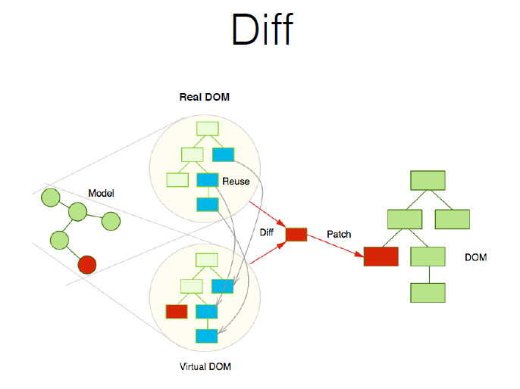

Slide 3
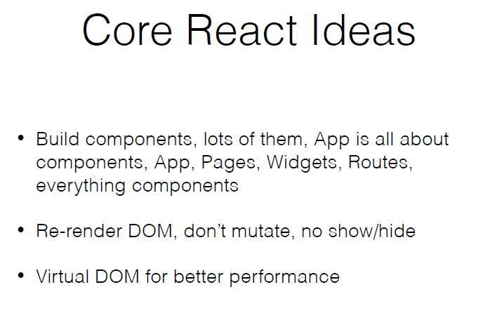

Slide 4
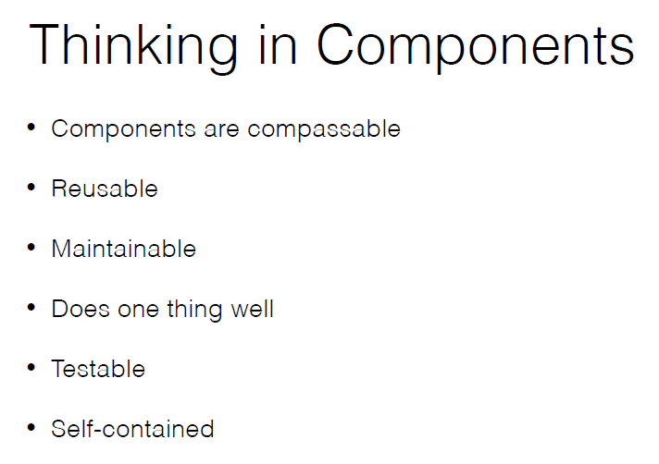

Slide 5
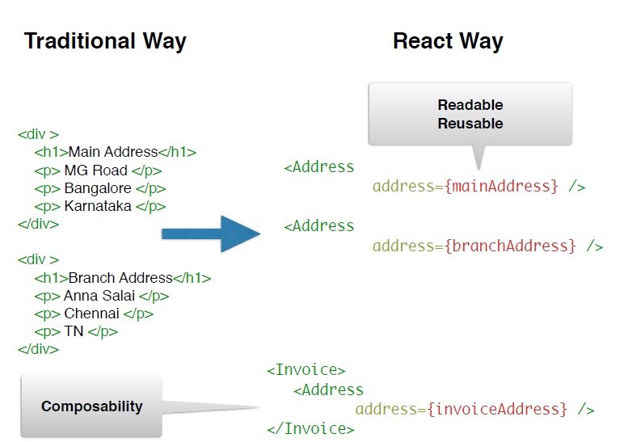

Slide 6
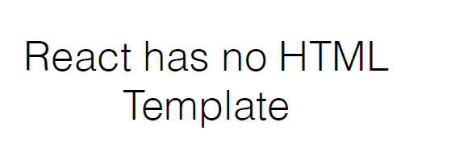

Slide 7
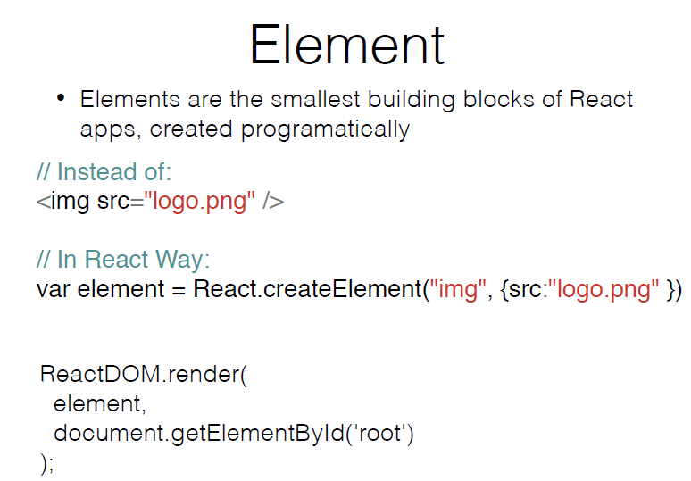

Slide 8
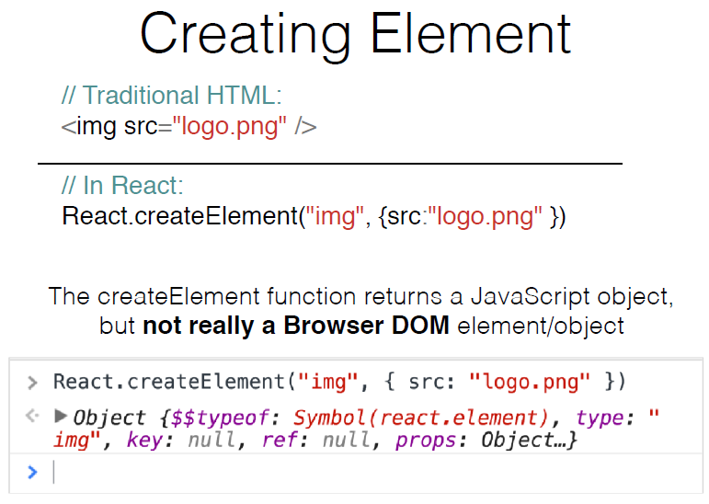

Slide 9
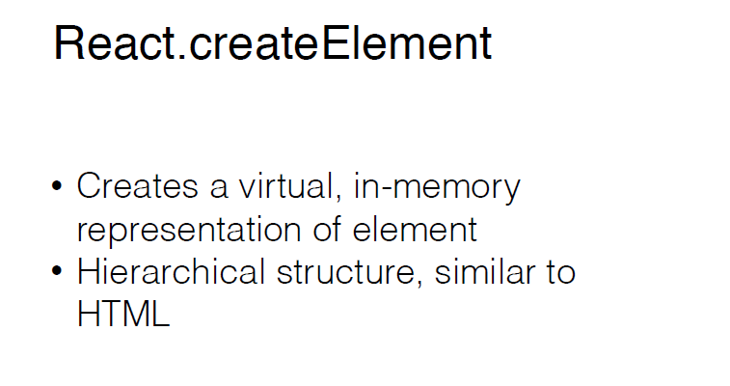

Slide 10
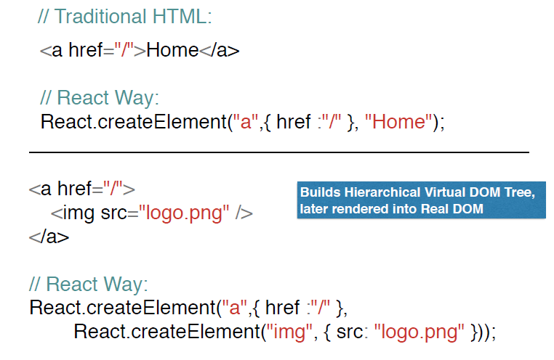

Slide 11
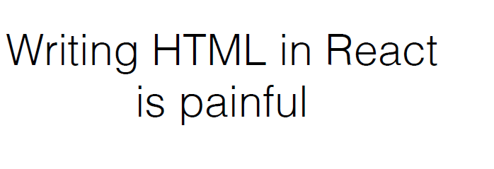

Slide 12
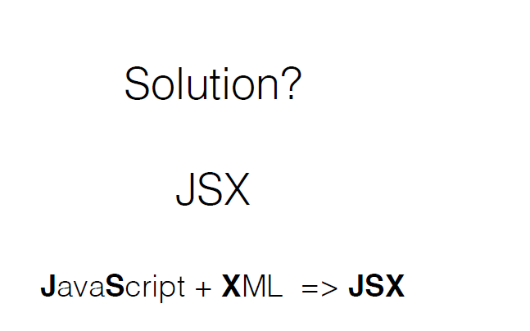

Slide 13
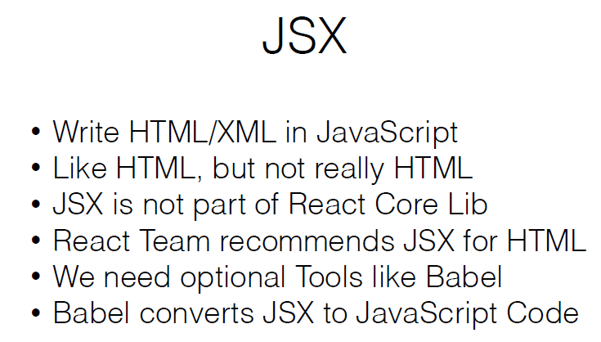

Slide 14
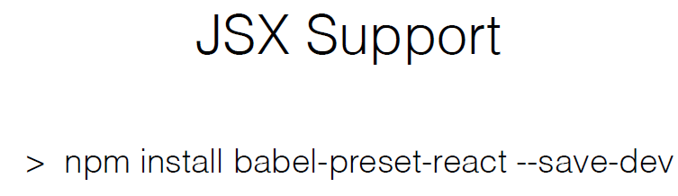
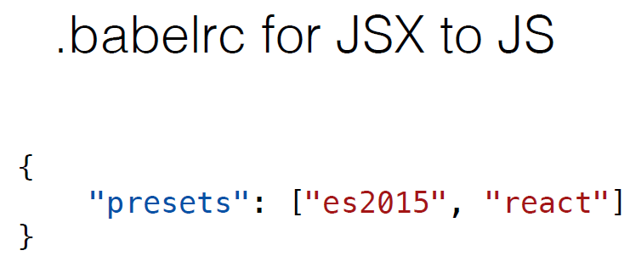

Slide 15
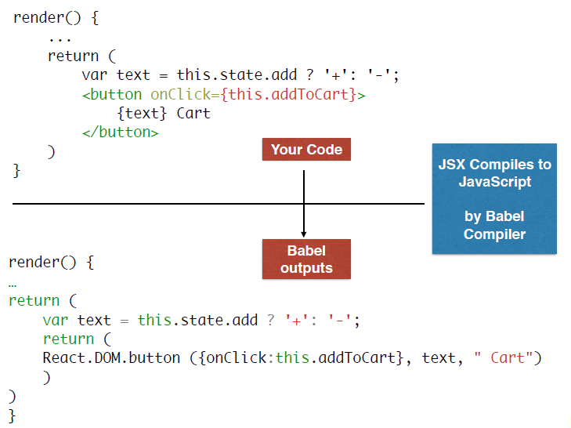

Slide 16
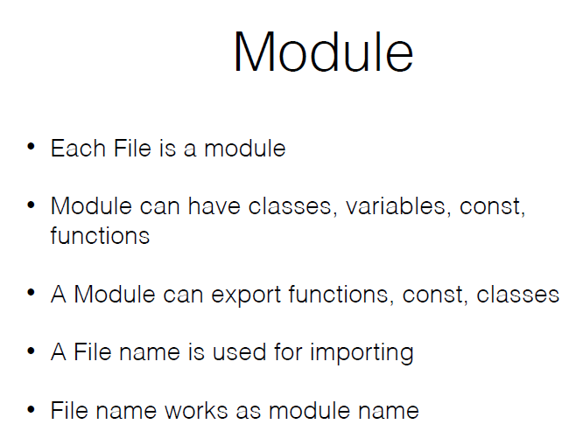

Slide 17
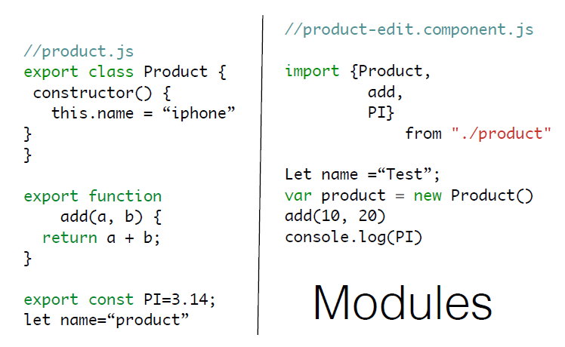

Slide 18
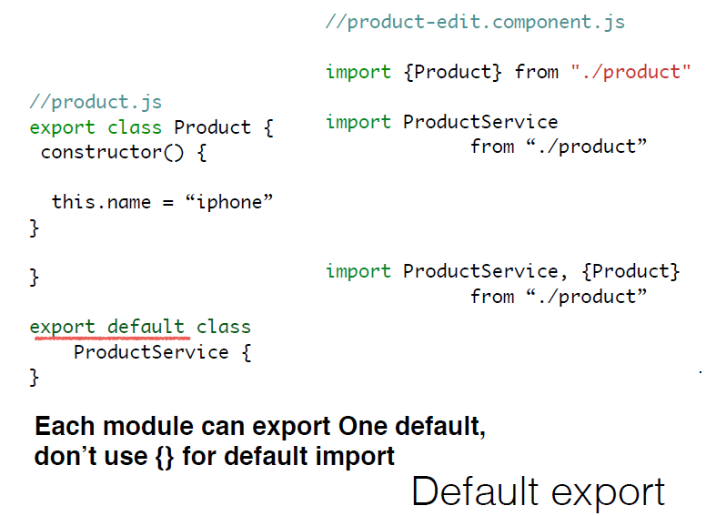

Slide 19
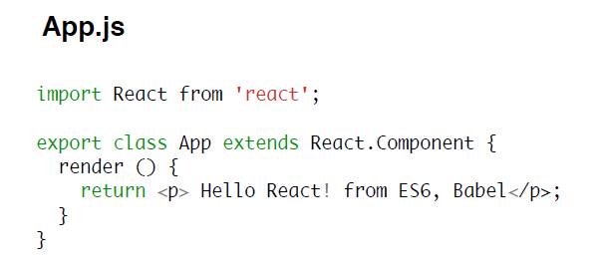
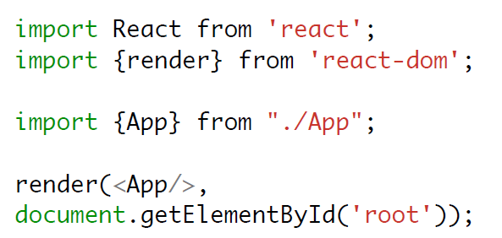

Slide 20
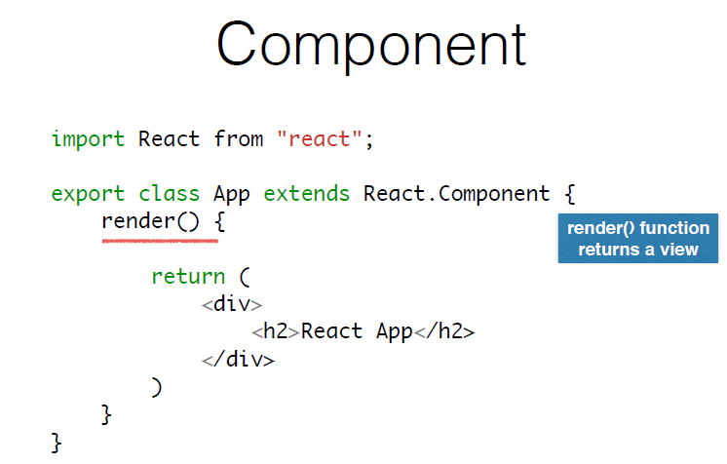

Slide 21
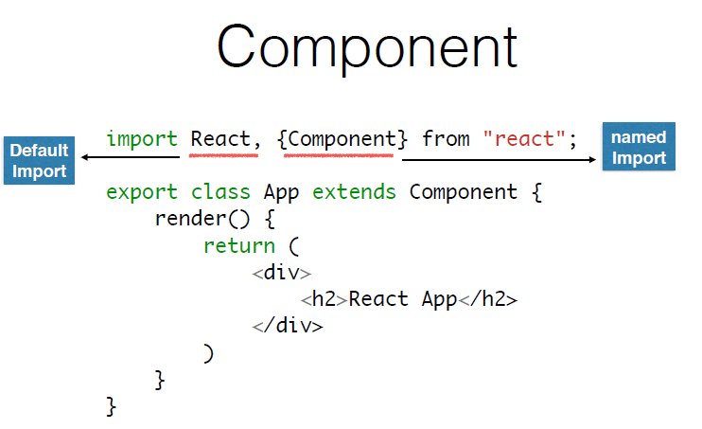

Slide 22
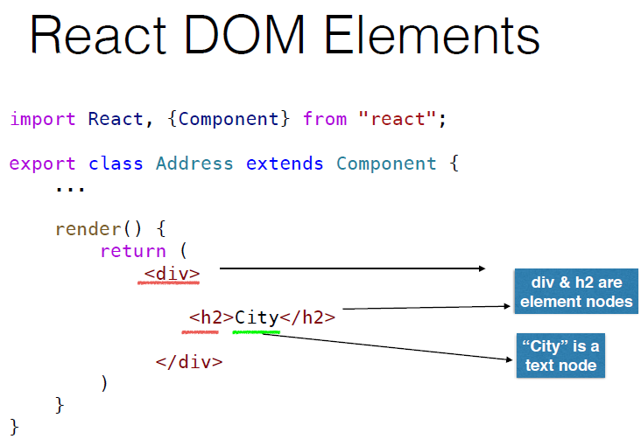

Slide 23
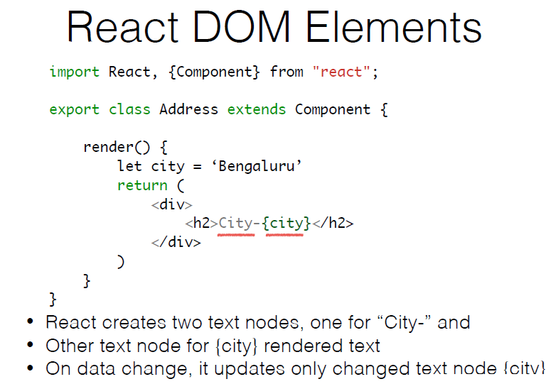

Slide 24
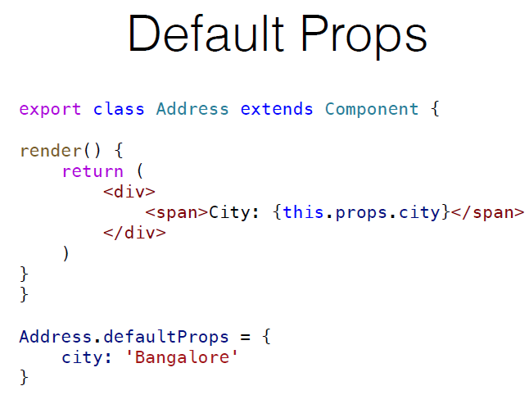

Slide 25
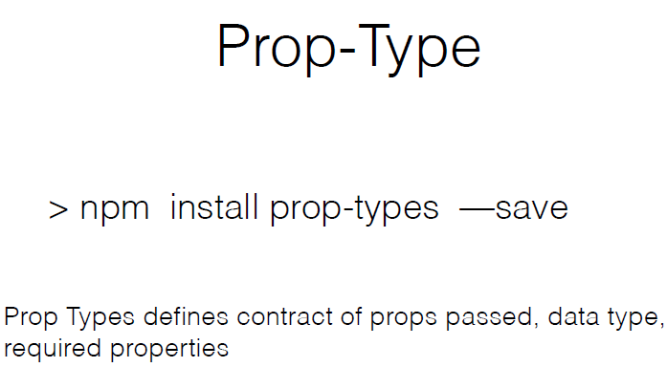

Slide 26
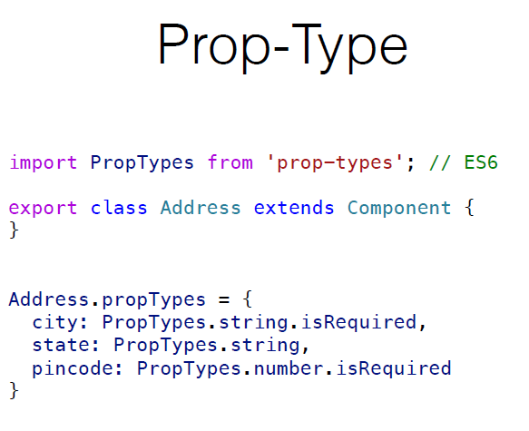

Slide 27
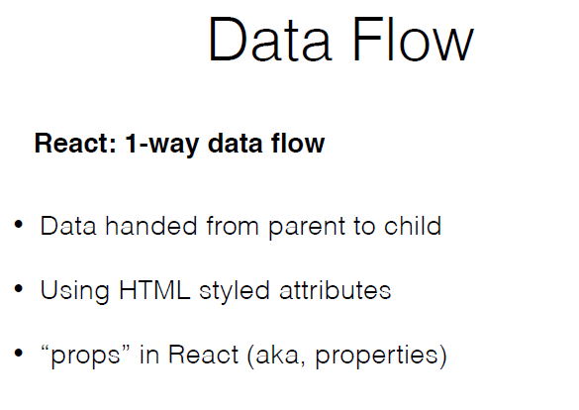

Slide 28
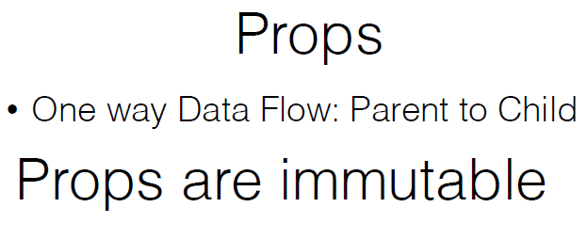
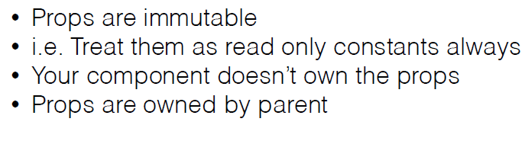

Slide 29
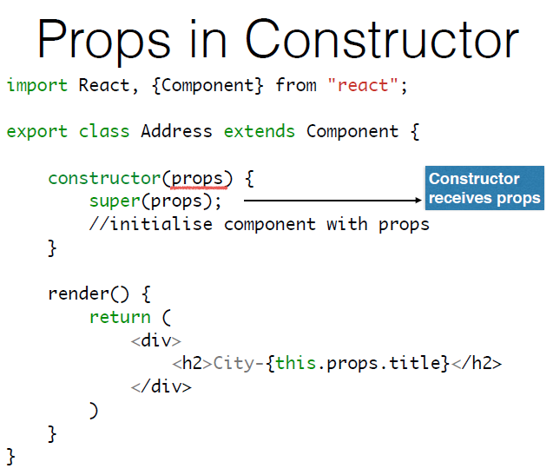

Slide 30
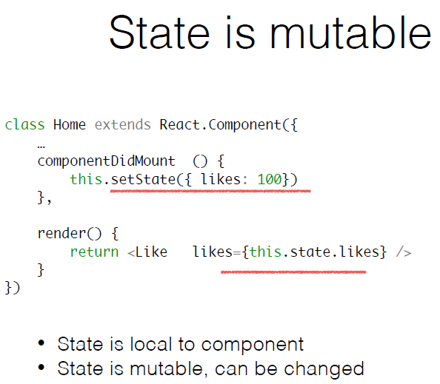

Slide 31
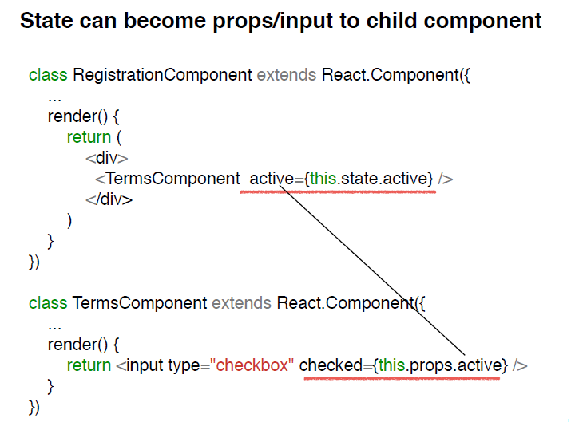

Slide 32
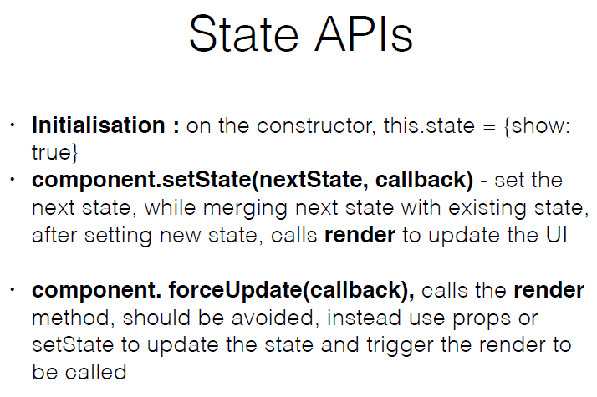

Slide 33
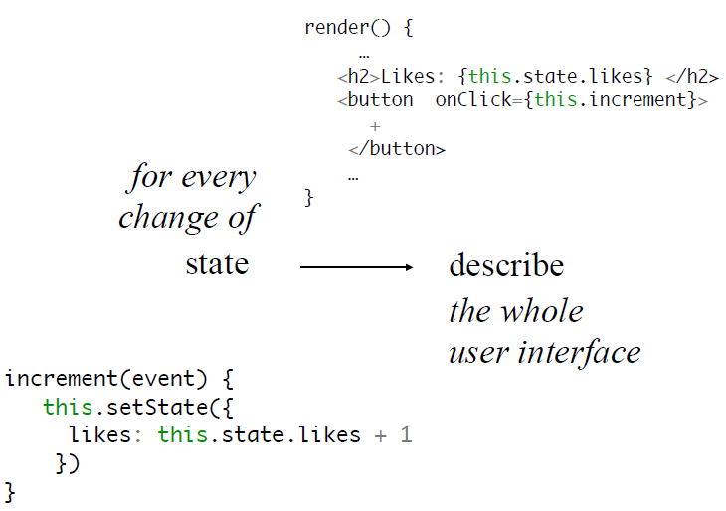

Slide 34
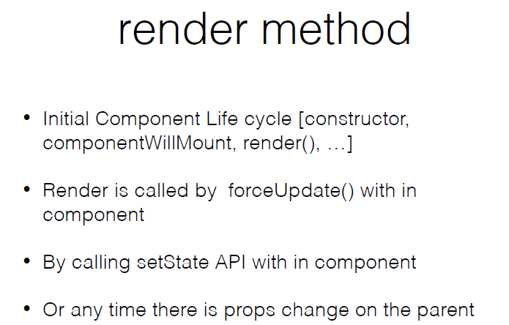

Slide 35
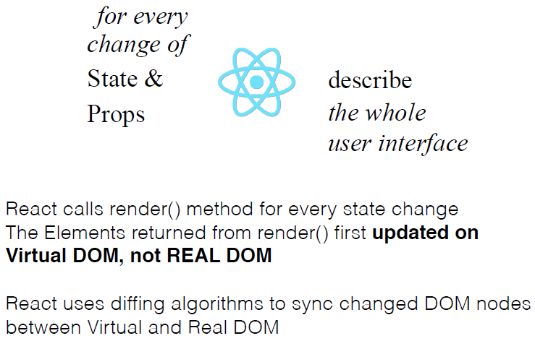

Slide 36
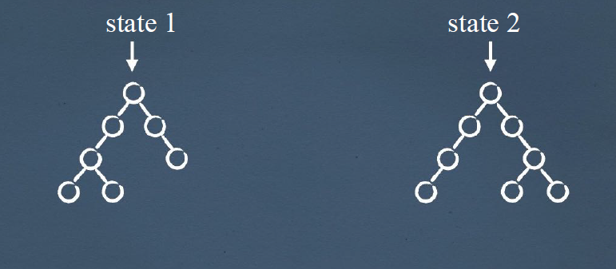

Slide 37
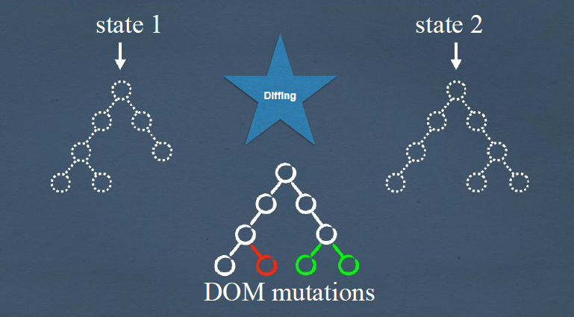

Slide 38
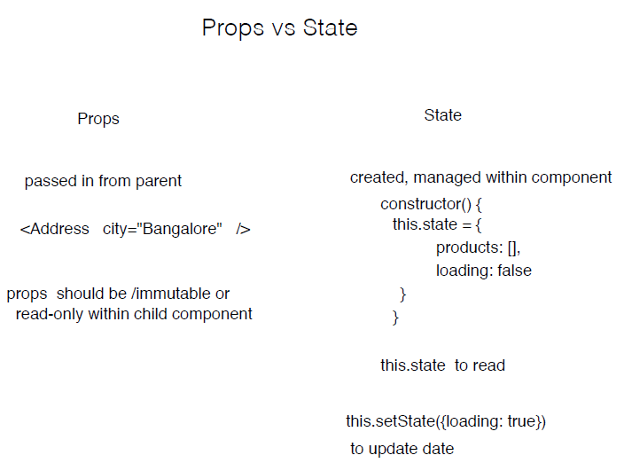

Slide 39
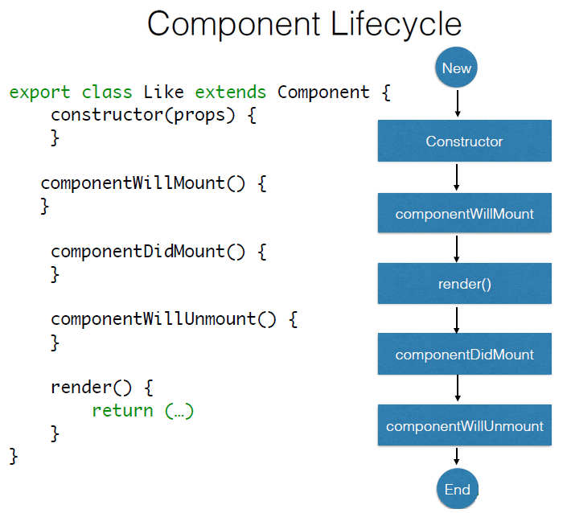

Slide 40
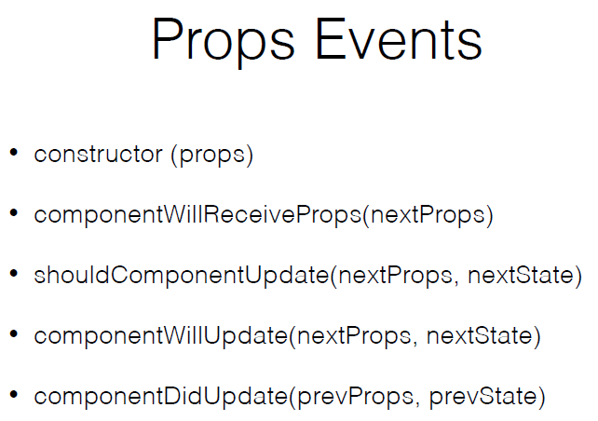

Slide 41
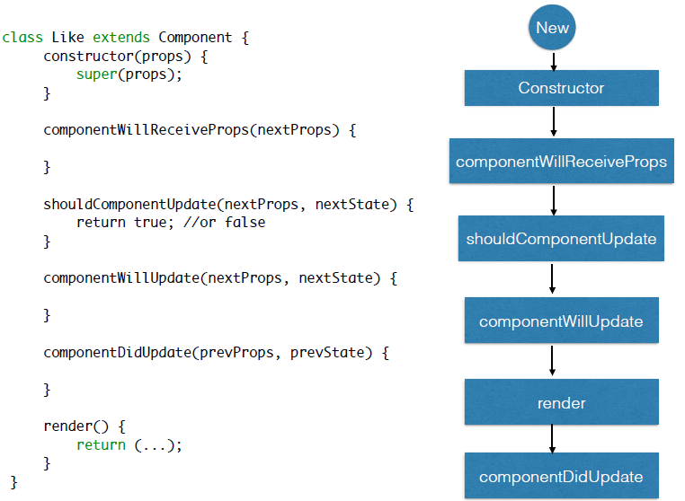

Slide 42
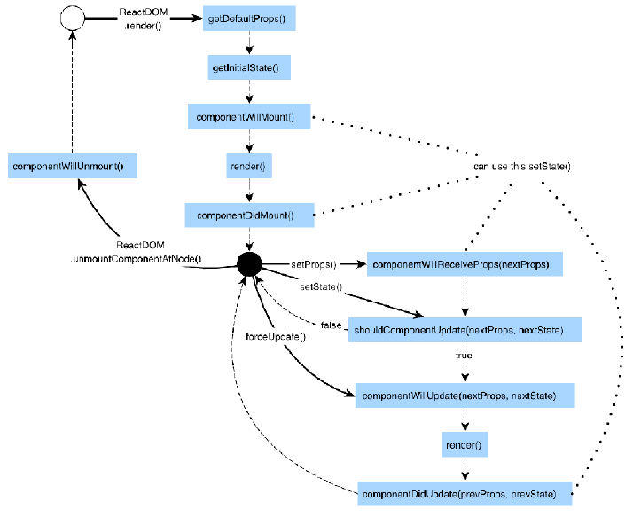

Slide 43
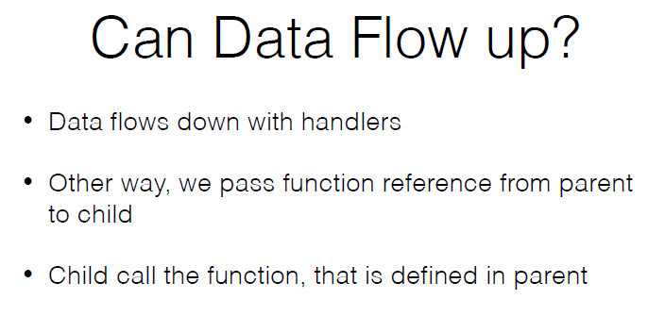
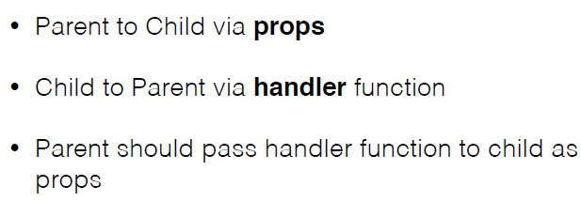

Slide 44
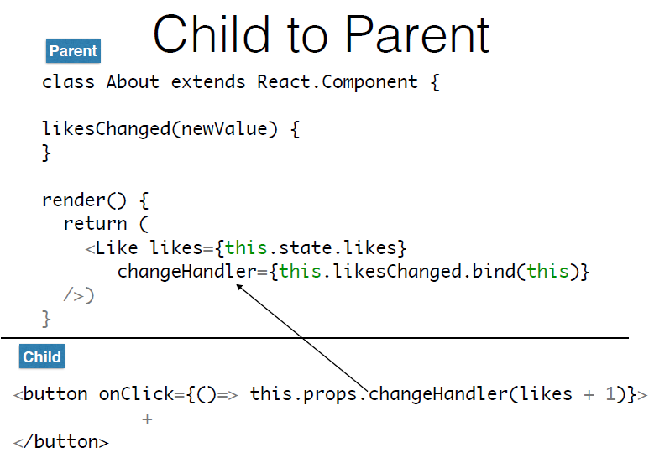

Slide 45
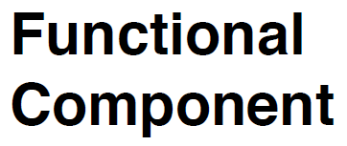

Slide 46
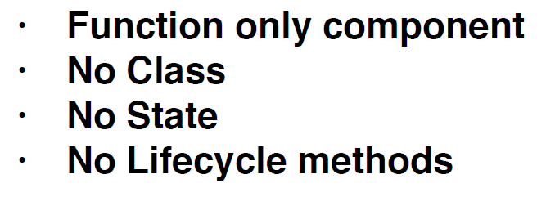

Slide 47


Slide 48


Slide 49


Slide 50


Slide 51


Slide 52


Slide 53


Slide 54


Slide 55


Slide 56


Slide 57


Slide 58

React - Design patterns.

Slide 59
Components

Slide 60
COMPONENTS
BUILDING BLOCK OF REACT APPLICATION
STATEFUL
STATELESS
FUNCTIONAL
PURE COMPONENTS
FRAGMENTS
Notes:
feature/base_components
feature/base_components_v2

Slide 61

Stateful
Notes:
https://github.com/vkum29/react-design-patterns/blob/feature/base_components/src/img/index.js

Slide 62

StateLess
Notes:
https://github.com/vkum29/react-design-patterns/blob/feature/base_components/src/text/index.js

Slide 63

Functional
Notes:
https://github.com/vkum29/react-design-patterns/blob/feature/base_components/src/header/index.js

Slide 64

PUreComponent
Notes:
https://github.com/vkum29/react-design-patterns/blob/feature/base_components_v2/src/article/index.js

Slide 65
Fragment
Notes:
https://github.com/vkum29/react-design-patterns/blob/feature/base_components_v2/src/article/index.js

Slide 66
Patterns

Slide 67
Container and Presentation

Slide 68

Container implements data and functional logic.
Presentation implements view logic.
Container is stateful component.
Presentation may or mayn't be stateful.
Use case
whenever we have heavy duty need from component, it can be broken into Container and Presentation.
Like we need to get data from server => Container Component.
We need to manipulate data, sort, filter, reduce or map to new data before usage => Container component.
Presentation contains styles not container.
Benefits
Separation of concerns
Better Reusability
Notes:
Stateful and Stateless components
Smart and Dumb components
Container: https://github.com/vkum29/react-design-patterns/blob/feature/container_presentation/src/articleContainer/index.js
Presentation: https://github.com/vkum29/react-design-patterns/blob/feature/container_presentation/src/article/index.js

Slide 69

Container
Notes:
https://github.com/vkum29/react-design-patterns/blob/feature/container_presentation/src/articleContainer/index.js

Slide 70

Presentation
Notes:
https://github.com/vkum29/react-design-patterns/blob/feature/container_presentation/src/article/index.js

Slide 71
Higher order Component

Slide 72

A HOC (Higher order component) receives a components and returns component with some extra dressing.
Uses composition to add extra or common behaviour to component
Does not mutate or change original component.
Use case
Factory like render component A or B.
Some common logic throughout components, like loader is great example of it.
Benefits:
Reusability
Factory pattern
Sharing common logic easily across components
Notes:
HOC = Higher order Component
WC = Wrapped Component
EC = Enhanced component
https://github.com/vkum29/react-design-patterns/blob/feature/loaderHOC/src/loaderHOC/index.js

Slide 73

HOC
Notes:
https://github.com/vkum29/react-design-patterns/blob/feature/loaderHOC/src/loaderHOC/index.js

Slide 74

Inclusion
Notes:
https://github.com/vkum29/react-design-patterns/blob/feature/loaderHOC/src/article/index.js

Slide 75
Controlled And Uncontrolled

Slide 76

Controlled components and uncontrolled components are used to handle form elements and their behaviour.
Most of this time we need controlled components
Controlled component manage the value, state and behaviour of element.
Uncontrolled component doesn’t manage them and is used only to render element.
Use case
Third party features or integration via uncontrolled components.
Login or any form interaction non third party.
Benefits
Easy to mange and handle changes with controlled components
Easy validation
Maintenance and integration.

Slide 77
Function as ChILD

Slide 78


Children api allows us to encapsulate children element inside desired structure. Though it is powerful we need more power, as many times view has to depends on data differences.
Use case
Render conditional block which parent should not know even.
Benefits
Abstraction and logical operations
Notes:
A.K.A render callbacks

Slide 79

Render callback
Notes:
https://github.com/vkum29/react-design-patterns/blob/feature/render_callback/src/renderCallback/index.js

Slide 80

Inclusion
Notes:
https://github.com/vkum29/react-design-patterns/blob/feature/render_callback/src/App.js

Slide 81
Context

Slide 82

Context or Provider pattern allows sharing of props without passing through each child.
Works as publisher and subscriber.
Uses Provider and Consumer component to achieve it with help of function as a child component.
Use case
Sharing of data across children without the cumbers of passing it through each nested child.
Benefits
Clean code
Better composition

Slide 83

Context
Notes:
https://github.com/vkum29/react-design-patterns/blob/feature/context/src/context/index.js

Slide 84

Provider
Notes:
https://github.com/vkum29/react-design-patterns/blob/feature/context/src/renderCallback/index.js

Slide 85

Consumer
Notes:
https://github.com/vkum29/react-design-patterns/blob/feature/context/src/article/index.js

Slide 86
Error Boundary

Slide 87

Prior to React 16, any error occurred while processing script has failed all subsequent components processing too.
Allow handling error and provide fallback.
Use case
Any component which is should handle a fallback in case of errors
Handling downtime of api or third party
Benefits
No more failure of complete app if nested comp fails
understandable way to provide error handling
Development shows error while production will show implemented fallback.

Slide 88

Error boundary
Notes:
https://github.com/vkum29/react-design-patterns/blob/feature/error_boundary/src/errorBoundary/index.js

Slide 89

Error simulation
Notes:
https://github.com/vkum29/react-design-patterns/blob/feature/error_boundary/src/errorBoundary/error.js

Slide 90
References

Slide 91
References
History
https://blog.risingstack.com/the-history-of-react-js-on-a-timeline/
Component
https://reactjs.org/docs/react-component.html
PureComponent
https://reactjs.org/docs/react-api.html#reactpurecomponent
Stateful and Stateless
https://stackoverflow.com/questions/34512696/reactjs-difference-between-stateful-and-stateless
functional
https://javascriptplayground.com/functional-stateless-components-react/
fragments
https://reactjs.org/docs/fragments.html
Composition
https://reactjs.org/docs/components-and-props.html#composing-components
https://reactjs.org/docs/components-and-props.html#extracting-components
Container and Presentation component:
https://medium.com/@learnreact/container-components-c0e67432e005
https://learn.co/lessons/react-presentation-components
https://medium.com/@dan_abramov/smart-and-dumb-components-7ca2f9a7c7d0

Slide 92
More references
HOC
https://reactjs.org/docs/higher-order-components.html
https://medium.com/@franleplant/react-higher-order-components-in-depth-cf9032ee6c3e
Controlled vs Uncontrolled
https://reactjs.org/docs/forms.html
https://reactjs.org/docs/uncontrolled-components.html
https://goshakkk.name/controlled-vs-uncontrolled-inputs-react/
Function as child
https://medium.com/merrickchristensen/function-as-child-components-5f3920a9ace9
Context
https://reactjs.org/docs/context.html
https://dev.to/kayis/context-in-react-69h
Error Boundaries
https://reactjs.org/docs/error-boundaries.html
PATTERNS:
https://www.youtube.com/watch?v=YaZg8wg39QQ
https://reactpatterns.com/
https://github.com/vkum29/react-design-patterns

Slide 93
“This is where we begin.”

